Slide 1
WELCOME TO OUR PROJECT PRESENTATION

Slide 2
CRM APPLICATION THAT HELPS TO BOOK A VISA SLOT
INTRODUCTION
OVERVIEW:
A Visa slot management project is a system that used to track and manage
the availability of visa slot, which are appoints that are required for certain for
visa slot applications. It might used by a government agency or a visa slots
to schedule and manage appointment with applicants.
PURPOSE:
Saving the time of the customers who want to book it by using CRM
application that helps to booking a visa slot. Wandering for booking the
visa slot and tracking can be reduce here. Reduce the paper filling as much
the Customer expecting. Ensuring the safety of the customers and
panic of many verification.

Slide 3
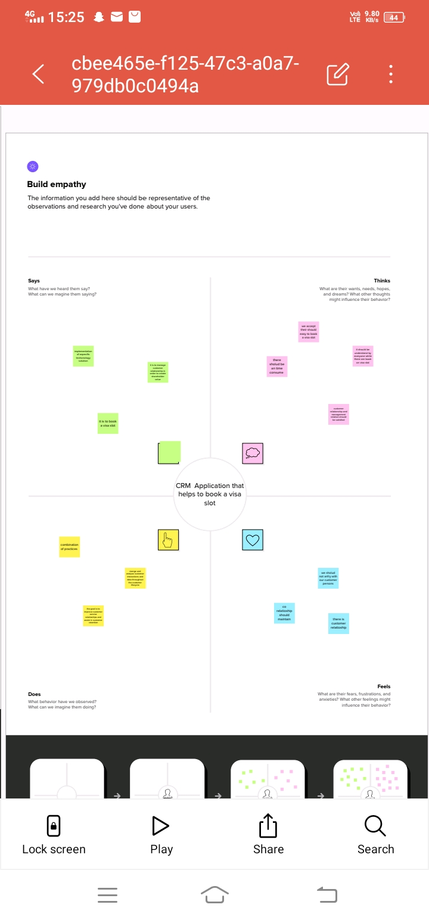
EMPATHY MAP

Slide 4
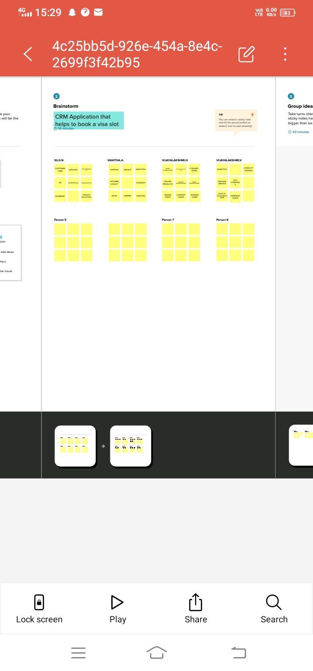

Slide 5
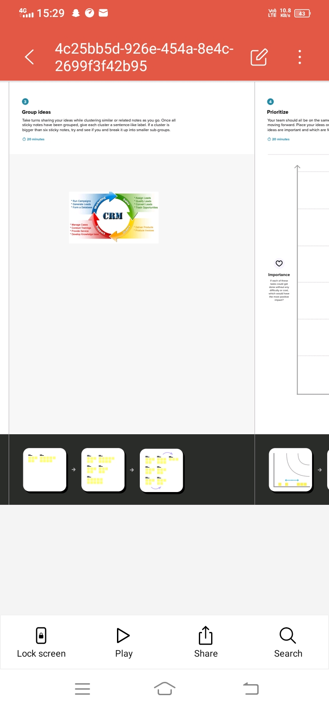

Slide 6
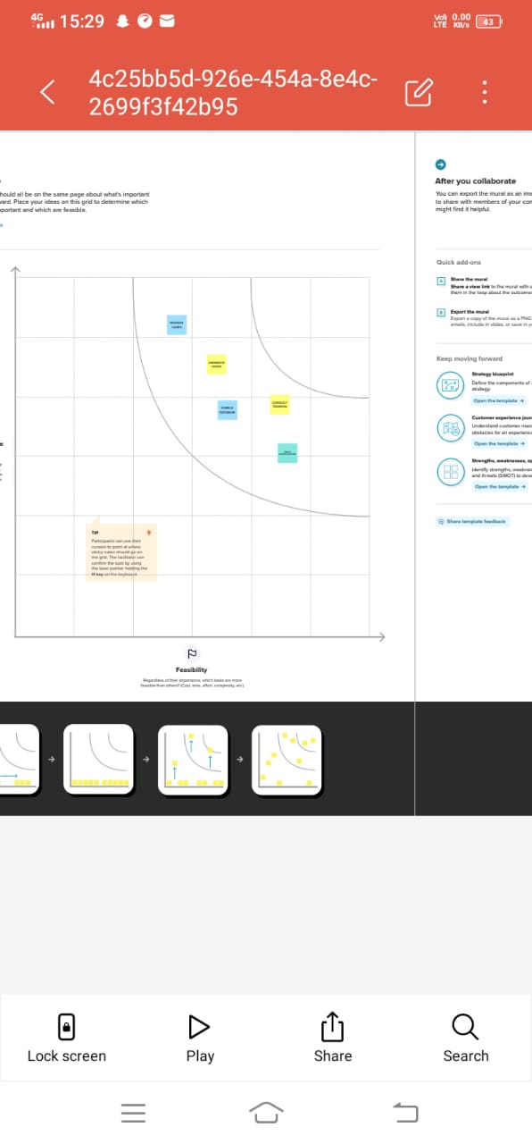

Slide 7
RESULT: Data model
OBJECT NAME | FIELDS IN THE OBJECT
Passport
Visa slot
Passports number Text
Visa slots name Number
Payments
Rescheduling/cancel
Payments Number
Location Text

Slide 8
ACTIVITY AND SCREENSHOTS
Creation of Salesforce Platform
Go to Developer.Salesforce.com and click on sign up. Enter our Detail as name,email,Role,company etc., Email is send your email id.
Go to inbox of the email that you used while sigining up. Click on the verify account to activate your account.

Slide 9
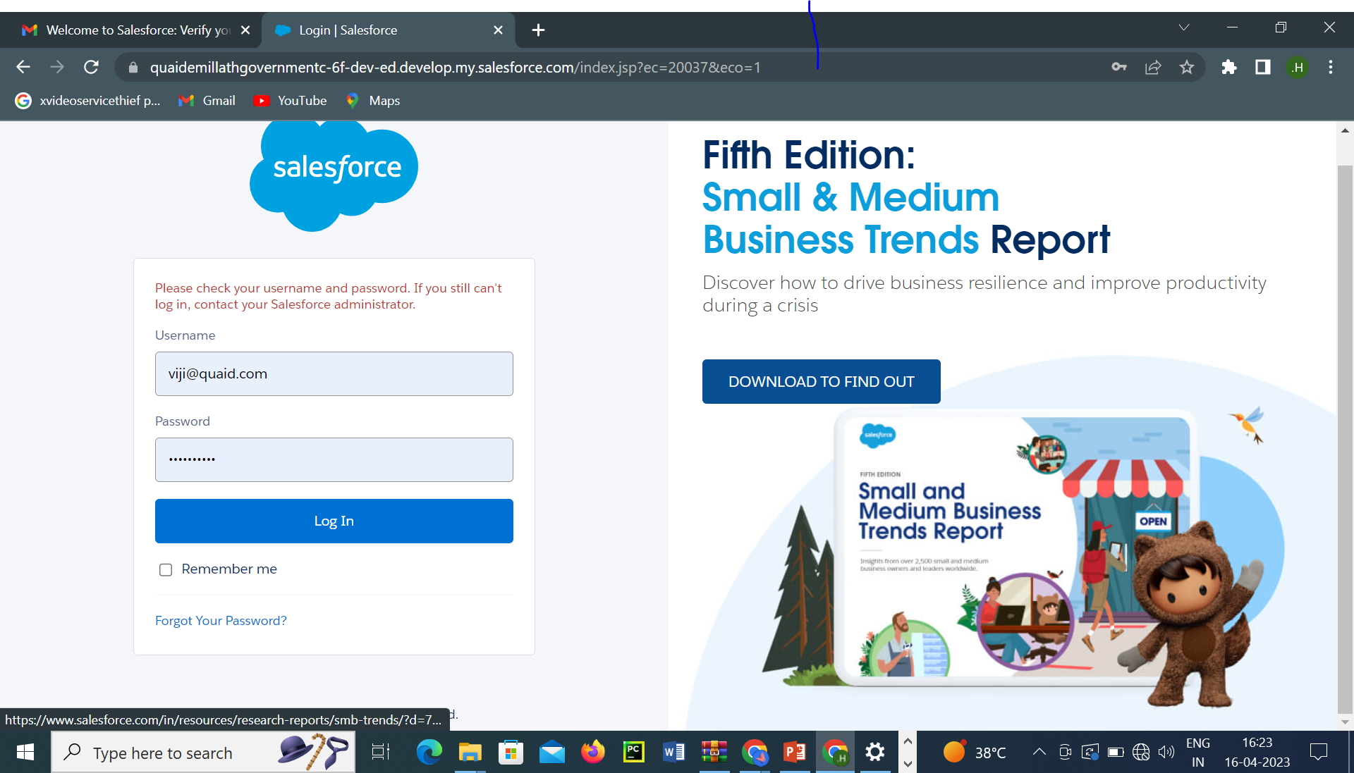

Slide 10
2.CREATION OF CUSTOM OBJECT: PASSPORT
navigate to setup to select the object manager and create the object gives the detail like label name Has passport and enter the plural name, record name ,data type, etc and save it
3.CREATION OF CUSTOM OBJECT: VISA SLOT
navigate to setup to select the object manager and create the object gives the detail like label name Has visa slot and enter the plural name, record name ,data type, etc and save it
4.CREATION OF CUSTOM OBJECT: PAYMENT
navigate to setup to select the object manager and create the object gives the detail like label name Has payment and enter the plural name, record name ,data type, etc and save it
5.CREATION OF CUSTOM OBJECT: RESCHEDULING/CANCEL
navigate to setup to select the object manager and create the object gives the detail like label name Has rescheduleing/cancel and enter the plural name, record name,data type, etc and save it

Slide 11
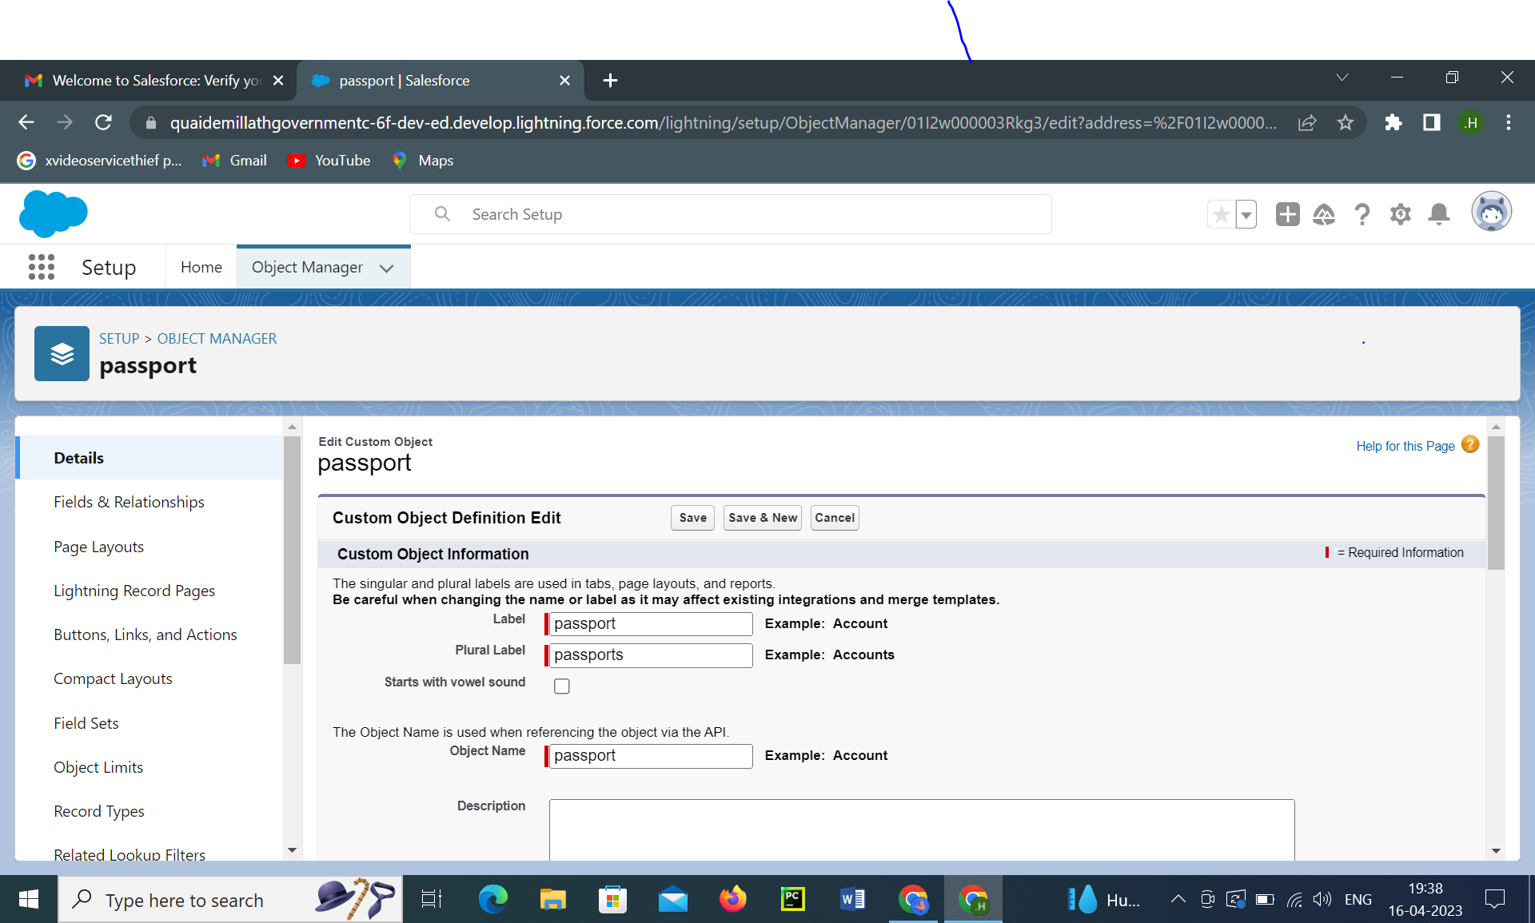

Slide 12
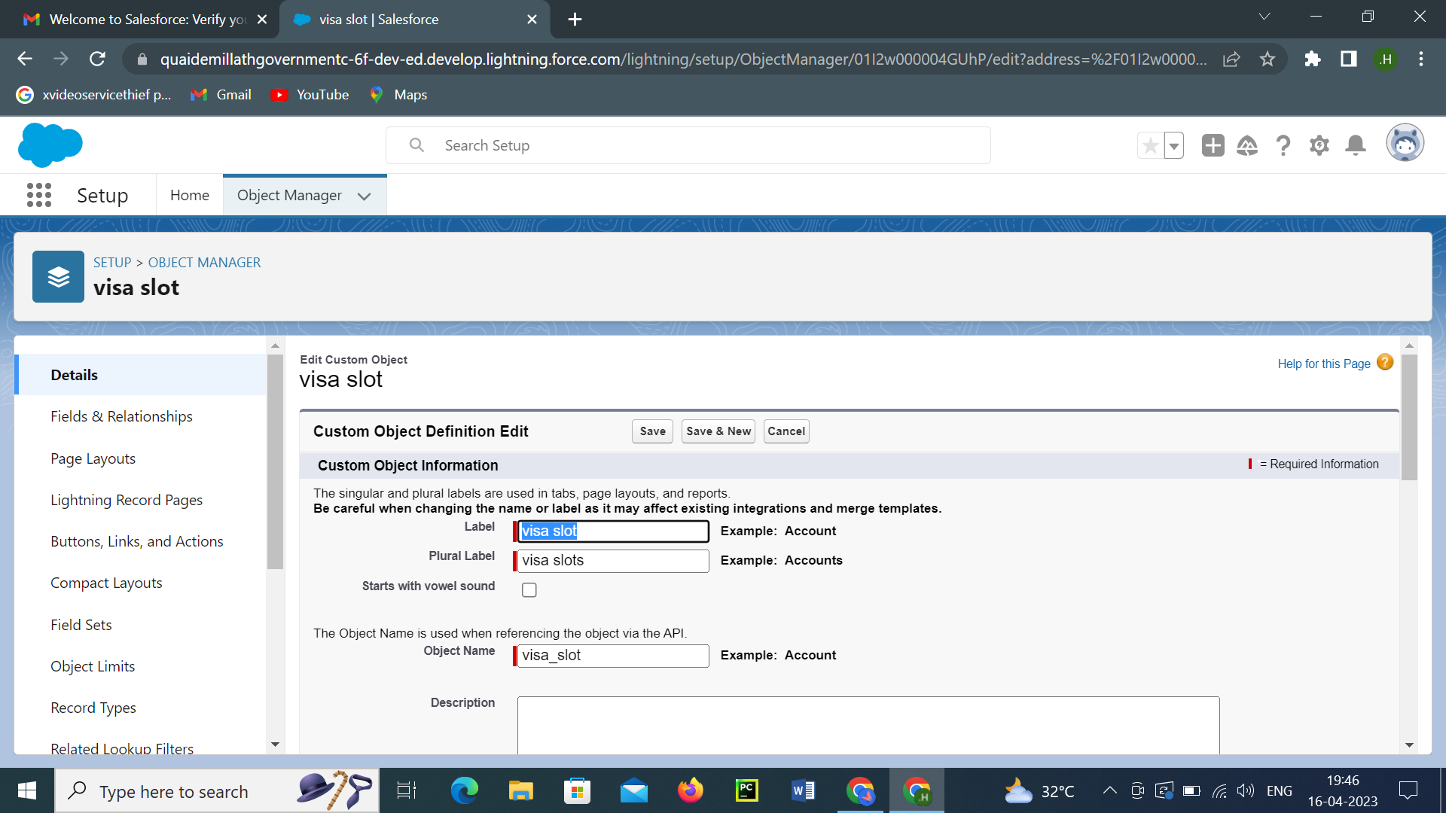

Slide 13


Slide 14
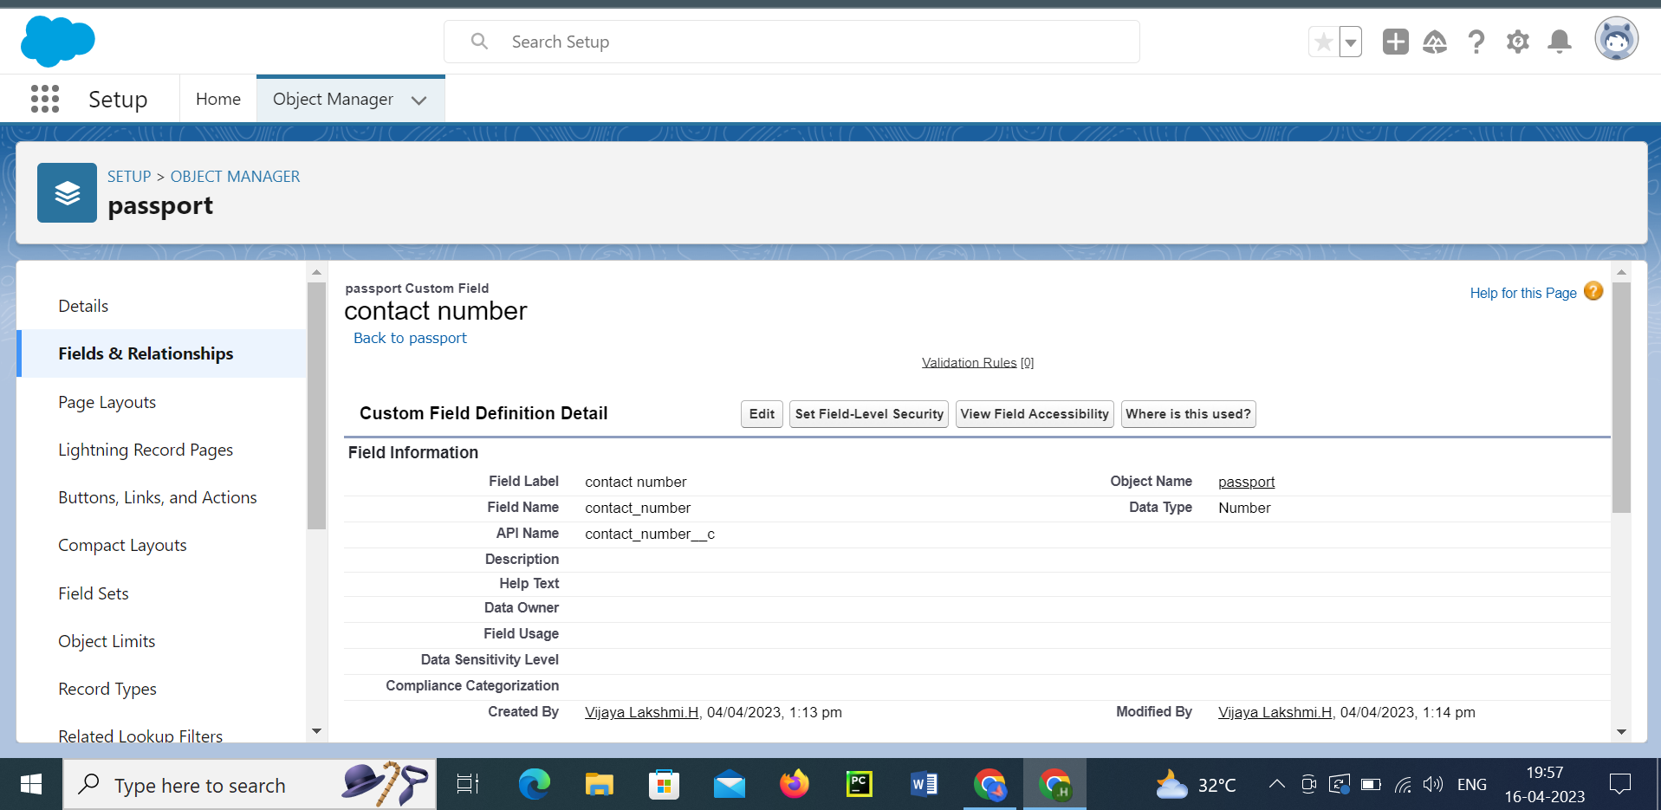

Slide 15
3.CREATION OF RELATIONSHIP: Relationship between objects
To create a Master Detail relationship between passport with visa slots. Select the object manger visa slot from the list and select the field and relationship and click new. The data type has master detail relationship and go to the next page and save it. To create the relationship between payment and bias slots

Slide 16
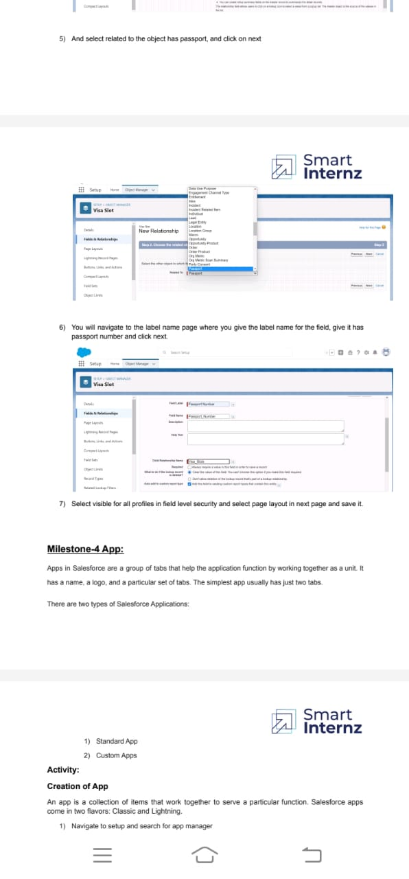

Slide 17
4. CREATION OF APP
Navigate to setup and search for app manager and select the new lightning app give the app name has book my visa. Upload picture to that and the navigation items like payments, passports, visa slot, reschedule/cancel. Select the system admin profile to available items to select items
5.CREATION OF USER
Navigate to setup in quick search bar .type user in and select it and quick click on new user. Give the last name and first name . Enter your mail it the field. Give all the profile to that username at the bottom of the page you can check the box to generate a new password and notify the user immediately.
6.CREATION OF REPORT
Click on the app launcher and search for reports and select the passports with visa slots for the report type name. select the start button to create a report.at the left side of the report you can find an outline pane and select the group has select location and columns has visa slot number.

Slide 18
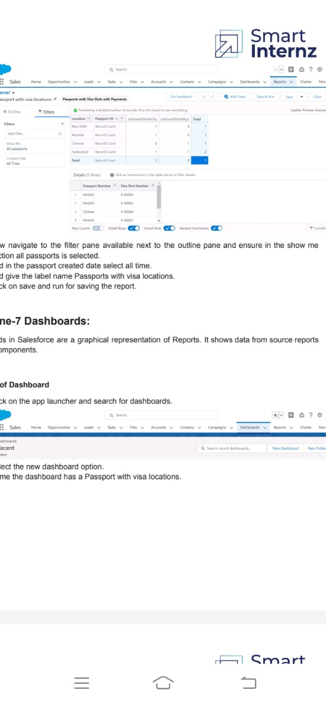

Slide 19
CREATION OF DASHBOARDS
Click on the app launcher and search for dashboards .name the dashboards has passport with visa locations. And select the create option now click on add component and for report select passports with locations. Select the donut chart in display of the location. Ensure that va;ue is record count and sliced by locations.click and save the dashboards.

Slide 20
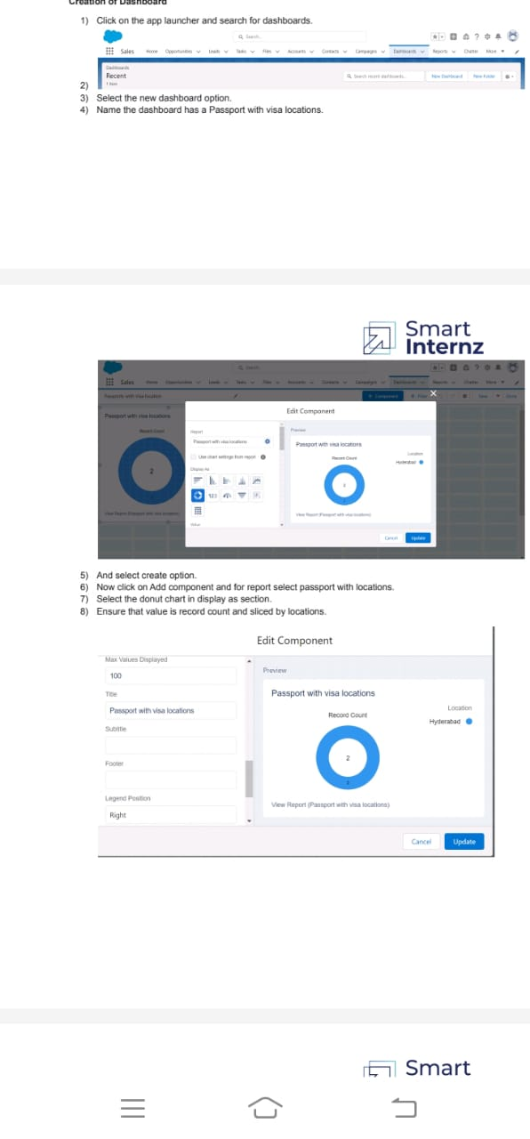

Slide 21
TRAILHEAD PROFILE PUBLIC URL
Team Lead- https://trailblazer.me/id/vijisari2001
Team Member 1-https://trailblazer.me/id/s9360798951
Team Member 2-https://trailblazer.me/id/vani27
Team Member 3-https://trailblazer.me/id/vijiammu14

Slide 22
ADVANTAGES
An efficient dashboard streamlines sales activities
Potential to add revenue
Increased sale revenue and reduced cost of sales
Increased customer satisfaction
Lower cost of recruiting customers
Increase customer retention in loyalty
customer knowledge
customization
It prevents the country from entry of unknown persons

Slide 23
DISADVANTAGES
Require top management support
Complicated and confusing
Problem in implementation
Fails to serve interested customers
Customer dissatisfaction
Poor connection
Lack of leadership
Can be costly

Slide 24
APPLICATIONS
This will help you to track and manage the availability of visa slot, which are appointments that are required for certain visa applications. CRM is a well conceived business strategy with long terms outcomes that maximize profitability, revenue and customer satisfaction by organising around customer segment, fostering customer satisfying actions and Implementing customer centric process. CRM is a strategy employed to learn and understand customer' need wants ad behaviour in order to develop stronger and sustained relationship with them.

Slide 25
CONCLUSION
VISA SLOT
By using the CRM application, we should track and manage the availability of visa slots easily. Booking of visa slots will be in an easier way. It is a beneficial and useful one for the customers. Save the time and often visiting trouble is not there.

Slide 26
FUTURE SCOPE
The future of CRM is about which companies will be able to pivot to meet the changing needs and trends- driven by customer expectations. Customer expect organisations to know a lot about them and except to have conversations.

